Slide 1



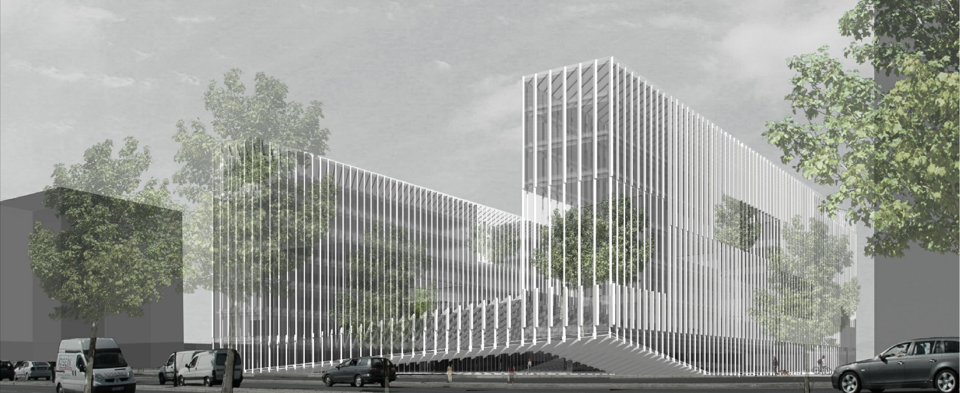


Presentation Title
Cybersecurity in the Electric Sector
Mission Critical Digital Ecosystems
WFER
September, 2026
Nuno Medeiros
Head of Mission Critical | CISO
Text Day/Month/2026

Slide 2
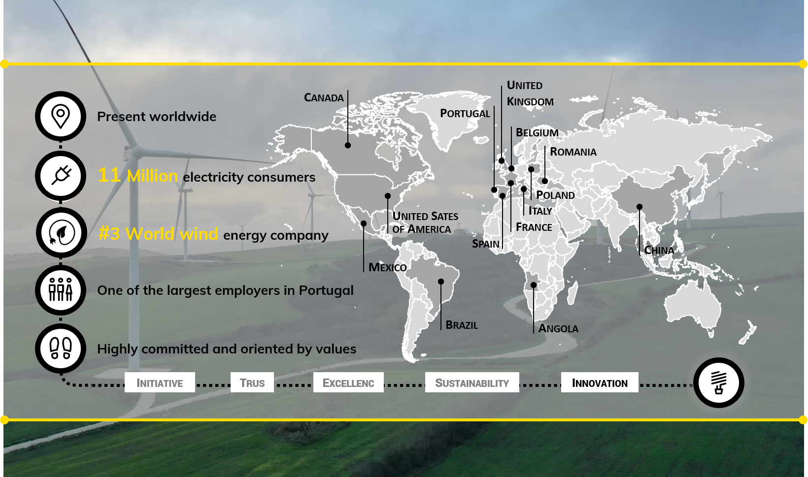
EDP GROUP IS TODAY A GLOBAL ENERGY PLAYER

Slide 3
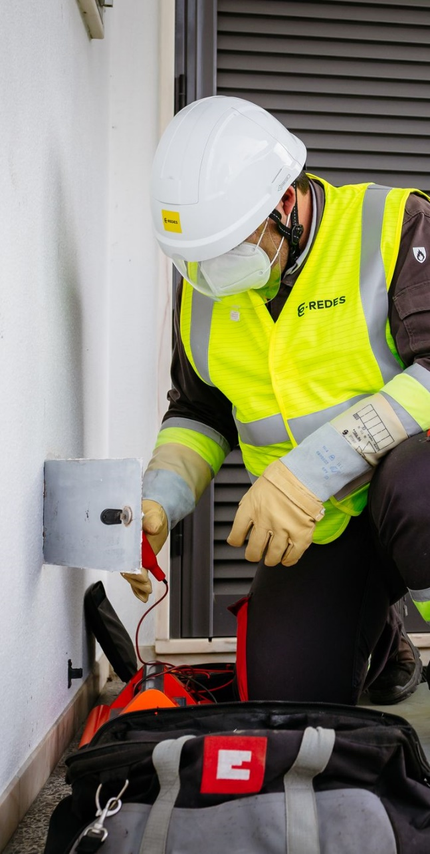
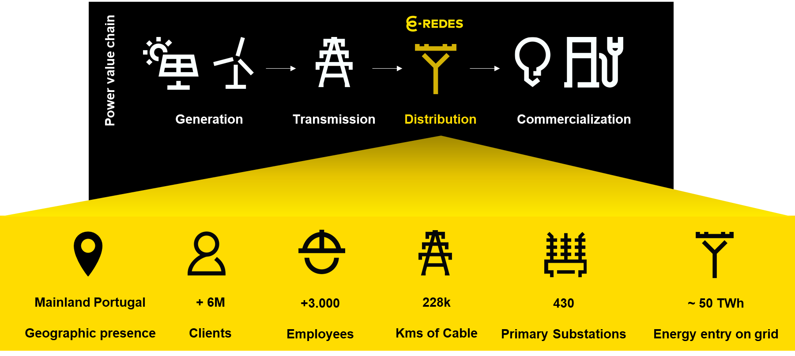
E-REDES: THE PT ELECTRICITY DISTRIBUTION COMPANY
The Portuguese National Electricity System includes E–REDES as the regulated electricity distribution company, acting under public service concessions.

Slide 4
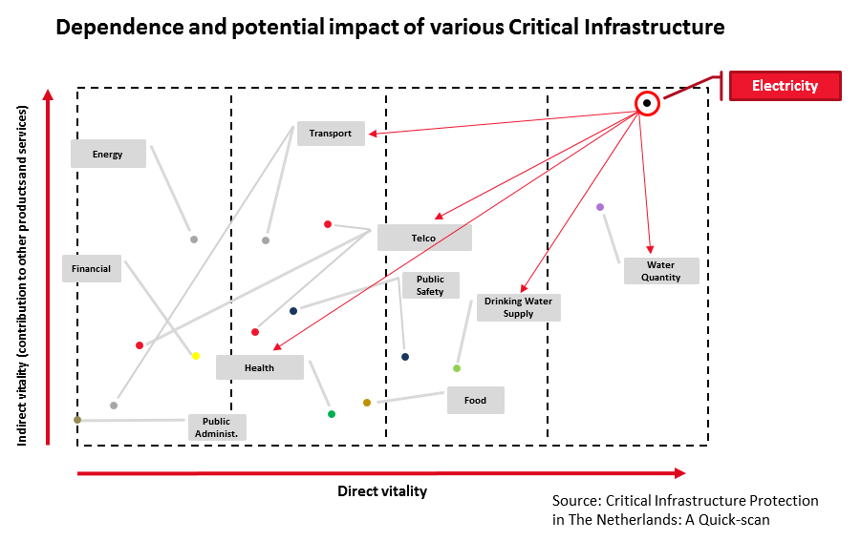
THE POWER GRID STANDS OUT IN ITS RELEVANCY
assets that are essential for the functioning of a society & economy
Electricity
Water
Transportation
Food
Health …

Slide 5
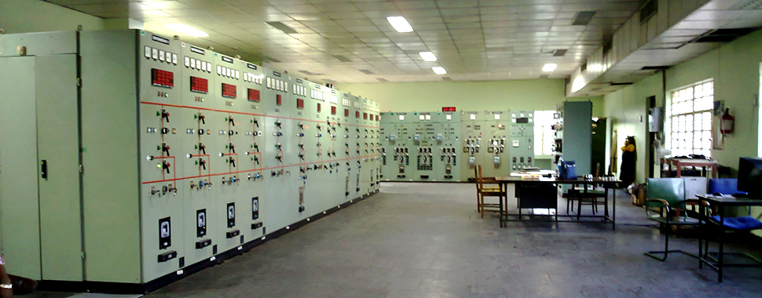
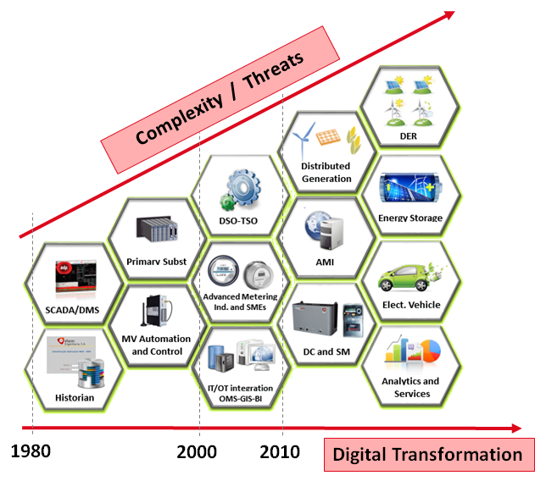
DSOS ARE UNDERGOING A VIBRANT TRANSFORMATION
Smart Grids
Advanced Metering Infrastructure
Renewables and DER
Automation & Sensoring
Electric Vehicle
Energy Efficiency
New business models

Slide 6
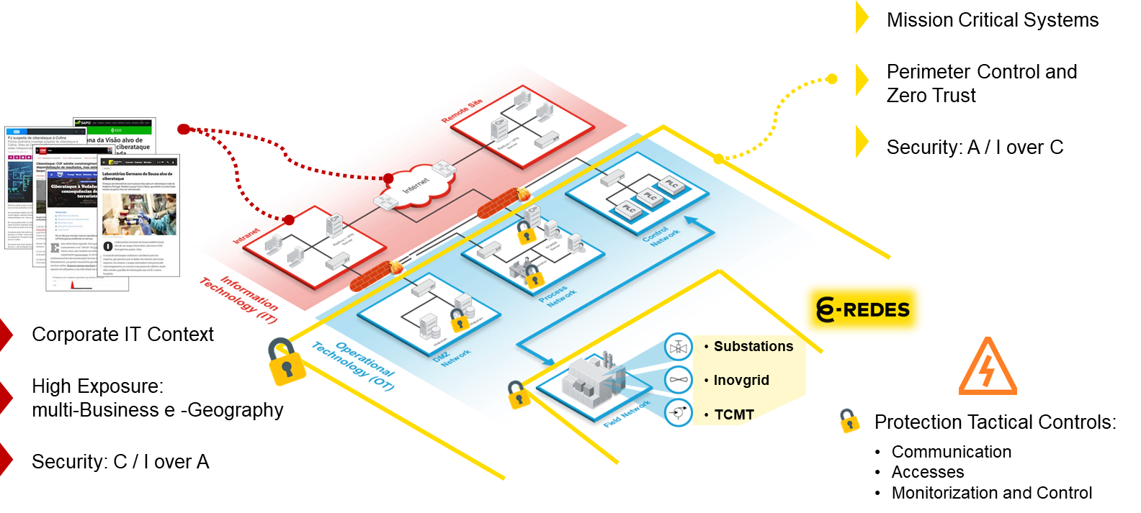
… DRIVING A DIGITAL JOURNEY AND NEW CHALLENGES
    Insider Threat
        Malicious or compromised employees, contractors and privileged users
        Abuse of legitimate access to disrupt operations, steal data or bypass controls
    Externally Generated Cyberattack
        External threat actors directly targeting EDP’s digital, IT and OT environments
        Exploitation of vulnerabilities, exposed services, identities or weak controls
Supply Chain Cyber Attack
        Compromise of suppliers, technology providers or other trusted third parties
        Attackers using legitimate connections, software or services as a pathway

Slide 7
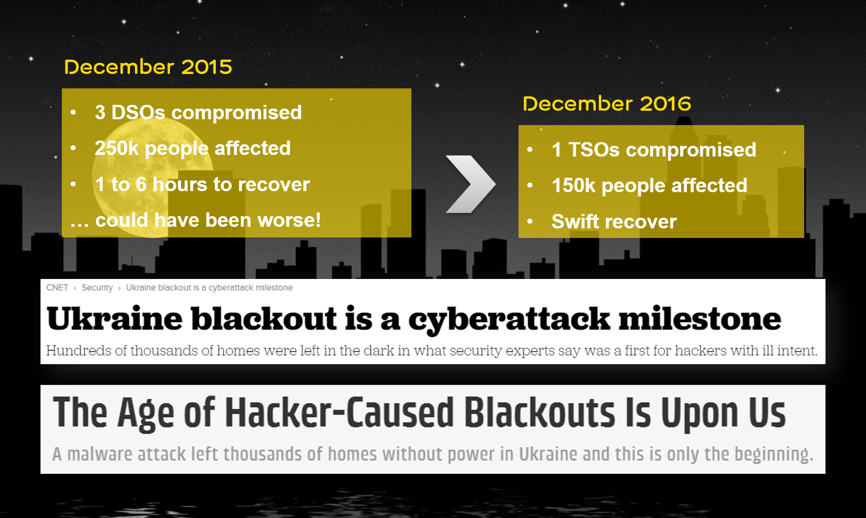
DIGITAL BLACKOUTS ARE REAL AND PARALYZING

Slide 8
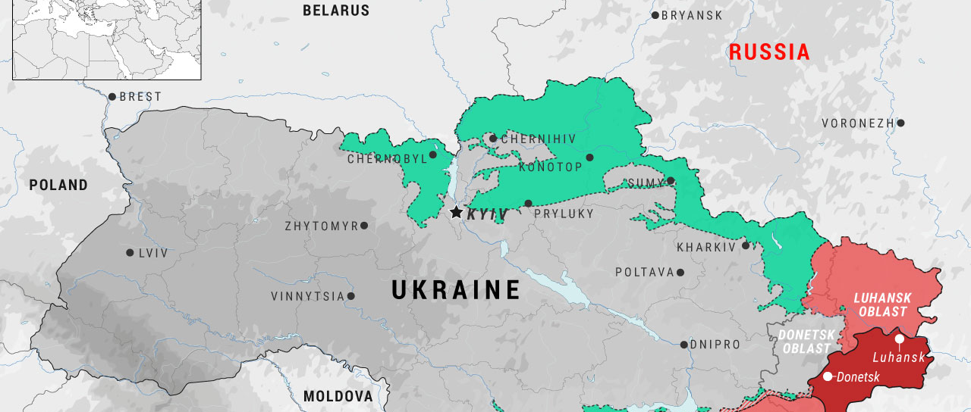
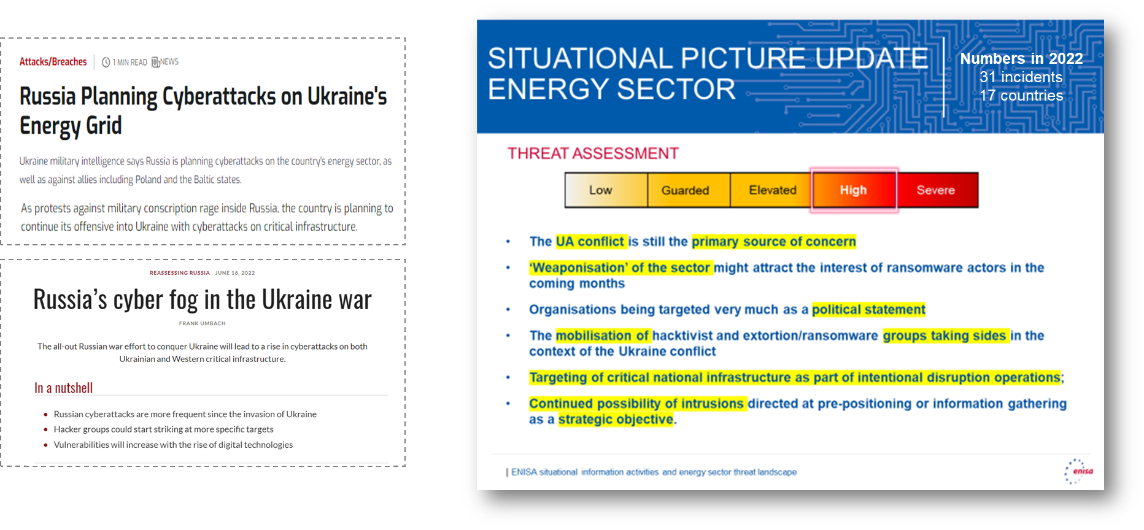
GEOPOLITICS IMPACTS THE THREAT LANDSCAPE

Slide 9

E-REDES HAS A COMPREHENSIVE STRATEGY
ADOPT THE BEST CYBERSECURITY PRACTICES AND STANDARDS IN ALIGNMENT WITH THE EDP GROUP
1
#complianceformaturity
MANAGE CYBERSECURITY RISKS ACROSS THE ENTIRE LIFECYCLE OF INFORMATION ASSETS
2
#fromzerotohero
STRENGTHEN OPERATIONS AND THE CYBERSECURITY ECOSYSTEM, WITH FOCUS ON IIMC (OT)
3
#expecttheunexpected
PROMOTE A TRANSVERSAL AND PARTICIPATORY CYBERSECURITY CULTURE
4
#inspiretoaspire
BOOST THE CYBERSECURITY MATURITY OF THE SECTOR AND SOCIETY
BOOST THE CYBERSECURITY MATURITY OF THE SECTOR AND SOCIETY
5
5
#sharingiscaring
#sharingiscaring

Slide 10
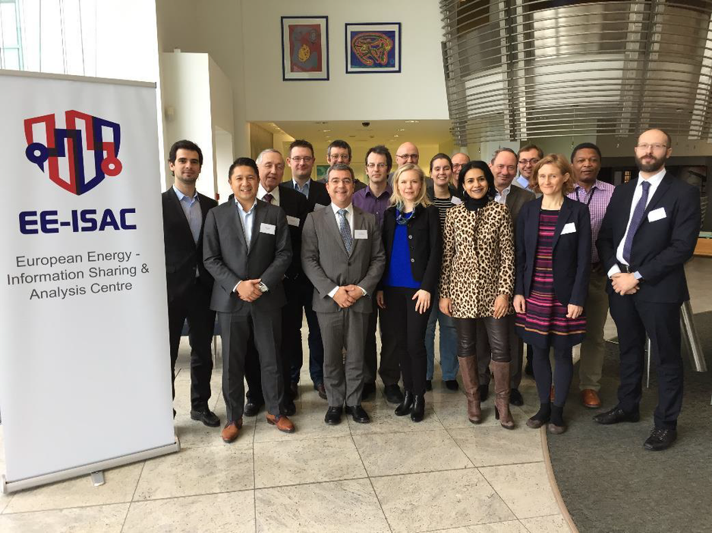
COLLABORATION – EE-ISAC ENGAGEMENT & MISSION
WHEN
Launched in 2015 to improve the resilience and security of the European energy infrastructure.
HOW
Through trust-based information sharing and by enabling a joint effort for the analysis of threats, vulnerabilities, incidents, solutions and opportunities.
WHAT
A community of communities to facilitate this proactive information sharing and analysis, allowing its members to take their own effective measures.

Slide 11
KEY FACTS & FIGURES
TASK FORCES • MEMBERS & PARTNERS • INFO SHARING PLATFORMS
6 TASK FORCES
MEMBERS & PARTNERS
2 INFO SHARING PLATFORMS
Membership & Partnerships
Threat Intelligence & Threat Landscape
Advocacy
Communications
Physical Security
Offshore Wind Sector
53 MEMBERS
MISP
13 MoU PARTNERS
3 INSTITUTIONS/AGENCIES
NextCloud
1 MoU IN PROCESS

Slide 12
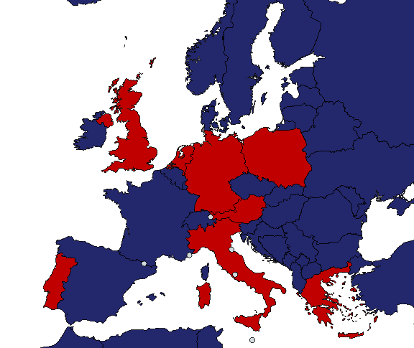
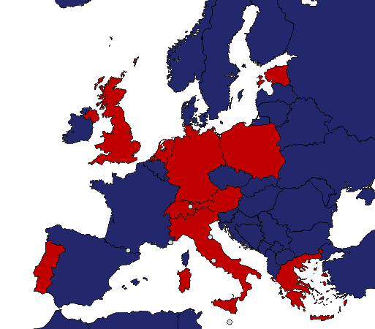
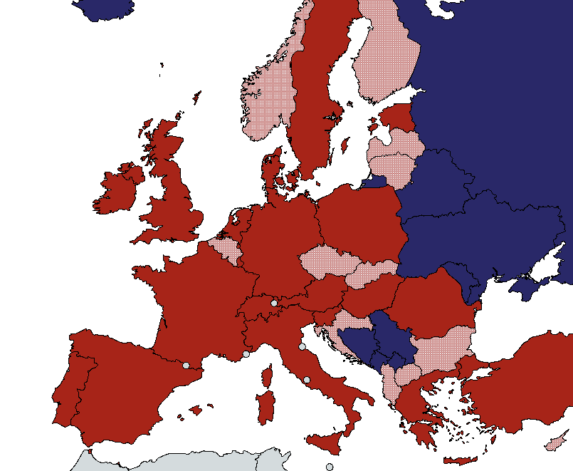
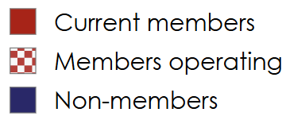
MEMBERSHIP EVOLUTION MAP
2016 (16)
2019 (27)
2026 (53)
© 2026 EE-ISAC. All Rights Reserved. Proprietary & Confidential

Slide 13

















PARTNERS & INTERNATIONAL REACH
MoU Partners (13)
Institutions & Agencies (3)
MOU in process (1)

Slide 14
Thank you
Nuno Medeiros
Grid Infrastructure Senior Director
NUNO.MEDEIROS@E-REDES.PT
communications@ee-isac.eu

